Slide 1
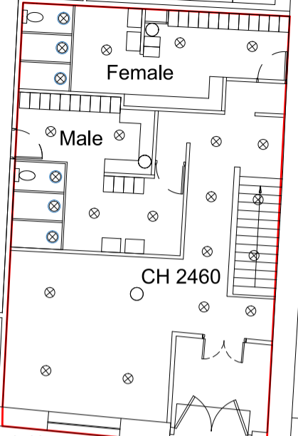
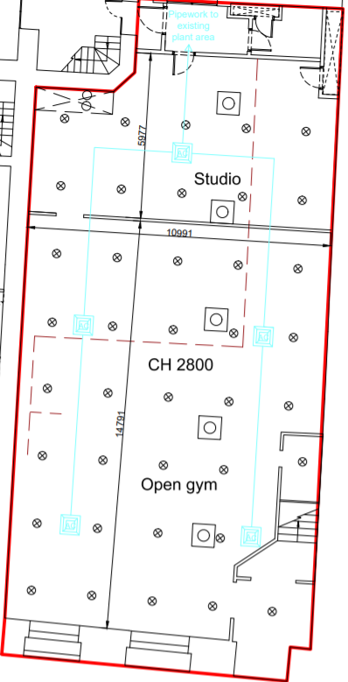
Floor Plans
In the event of fire, please leave through the signed Fire Exits
Ground Floor
Basement
STUDIO FIRE EXIT
Studio
Reception
Main Gym
FRONT DOOR FIRE EXIT
STAIRS up to
FRONT DOOR
FIRE EXIT

